Slide 1
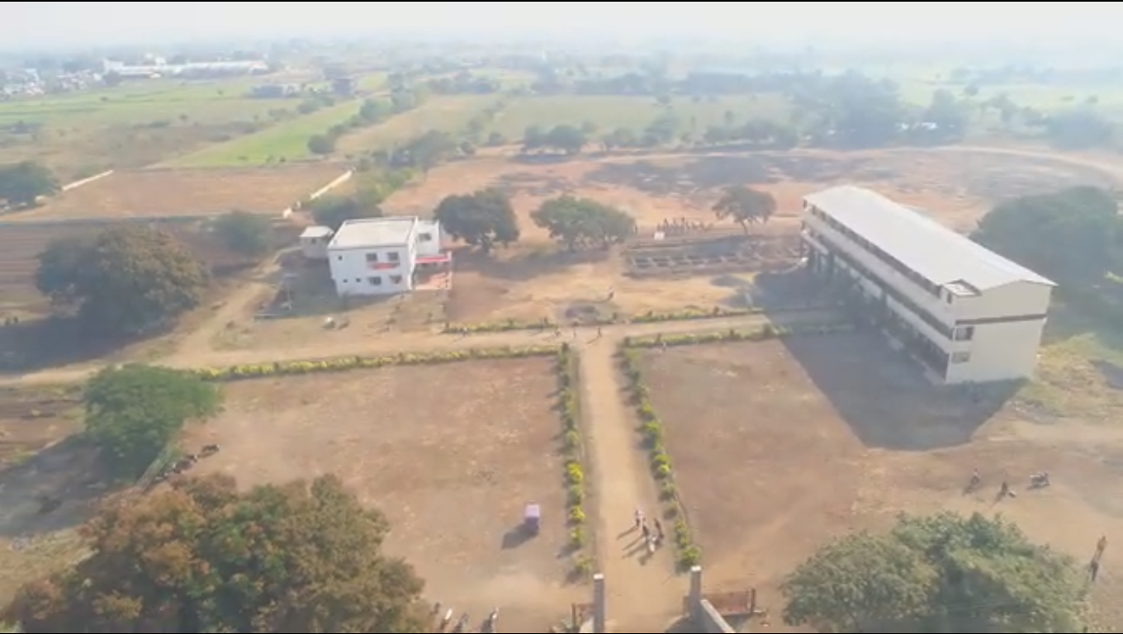
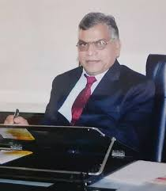
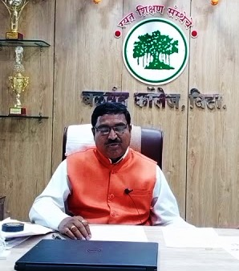
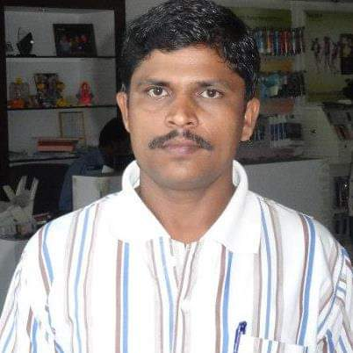
WELCOME TO AAA COMMITTEE
ART’S AND COMMERCE COLLEGE, MADHA
Prin.Dr. K.H.Shinde Prin.Dr. R.S. More Dr. P.S. Shirsat
Chairman Member Co-Ordinator

